Slide 1

Sprocket Central Pty Ltd
Data analytics approach
[Division Name] - [Engagement Manager], [Senior Consultant], [Junior Consultant]

Slide 2
Agenda
Introduction
Data Exploration
Model Development
Interpretation

Slide 3
Introduction
customers analysis
Sales by gender.
Profit by customer segments.
Profit by customer segments.
Job industry category.
Analysis based on brands.

Slide 4
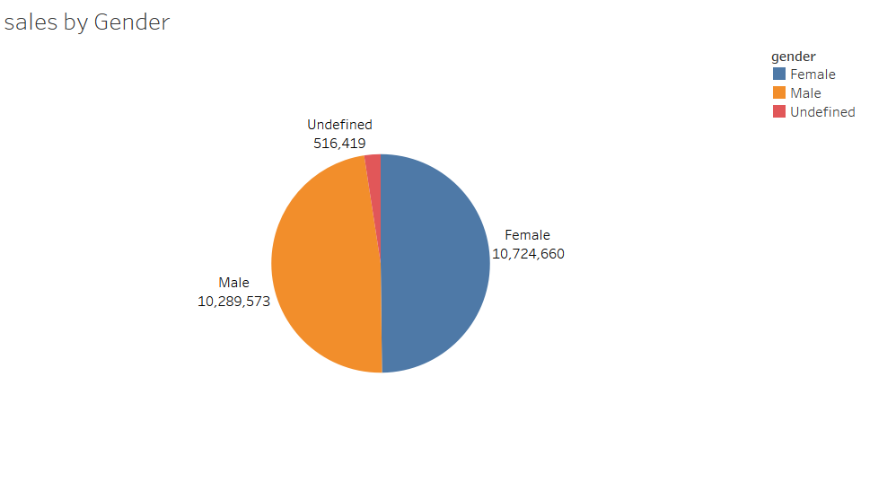
Data Exploration
Sales by Gender
Male customers count =10,289,573.
Female customers count =10,724,660.
Customers doesn’t mentioned there gender count =516,419.
More female customers have purchased the products. thus, manufacturing more products, bringing more attractive colors like pink and providing offers to females can improve sales.

Slide 5
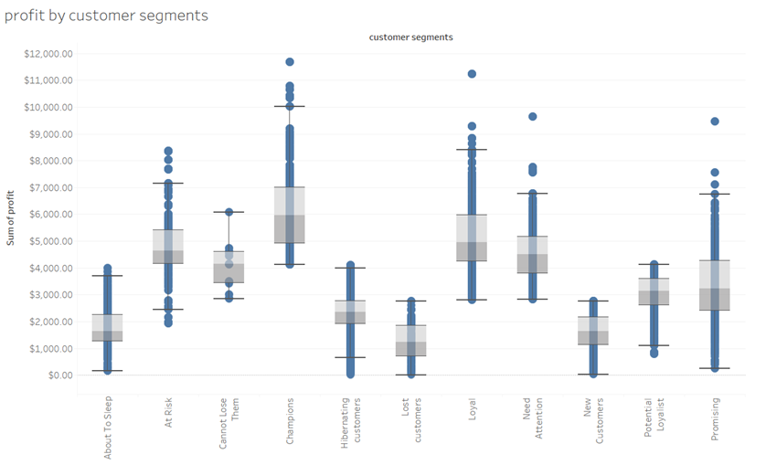
Data Exploration
Profit by customer segments
Champions had made more profit.
Loyal and promising customers had made more profits followed by champions.
Lost customers must be targeted and getting feed back from them can be helpful.
Providing offers may have chances of improving sales and can make profits from hibernating and about to sleep segmented customers.

Slide 6
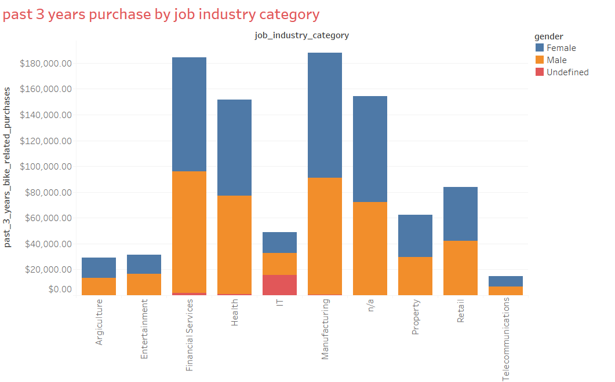
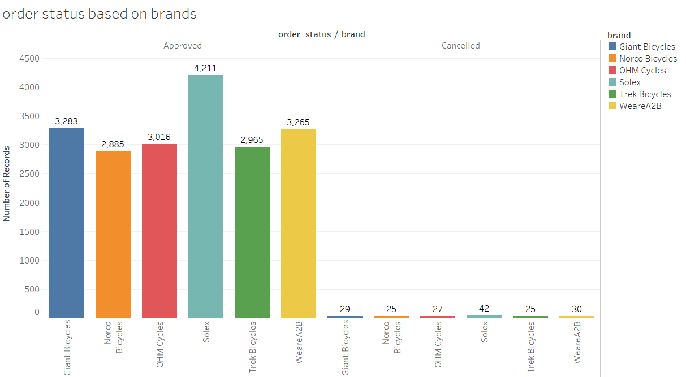
Data Exploration
Job industry category
Mostly our customers are from Finance industry and Manufacturing industry are on top 2. then health industry are next to them.
The rest industries is still in same positions
Analysis based on brands
Solex and WeareA2B are more likely to be cancelled by the customers.
Solex,WeareA2B and Giant Bicycles are most purchased brands by customers.

Slide 7
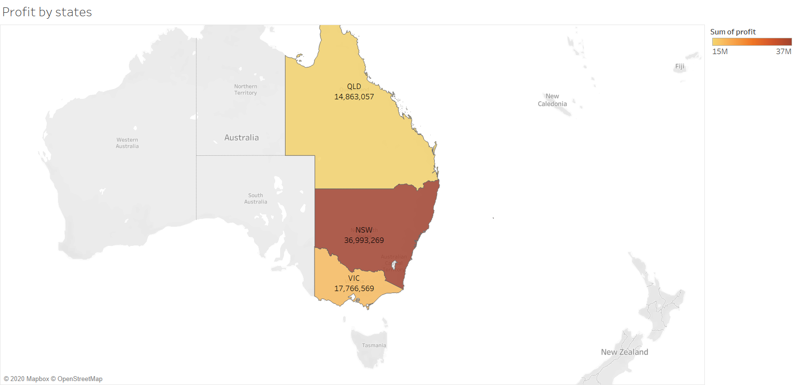
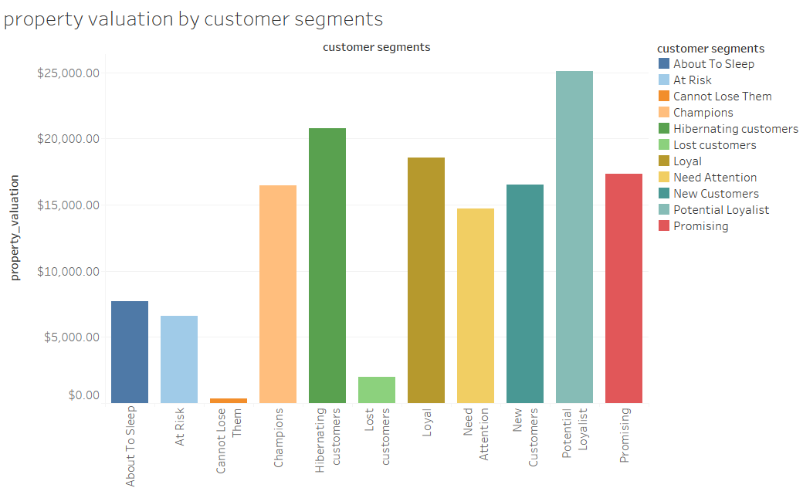
Data Exploration
Property valuation based on customer segments
Potential loyalist customers have higher property values.
More profits are from “New south wales” state.

Slide 8
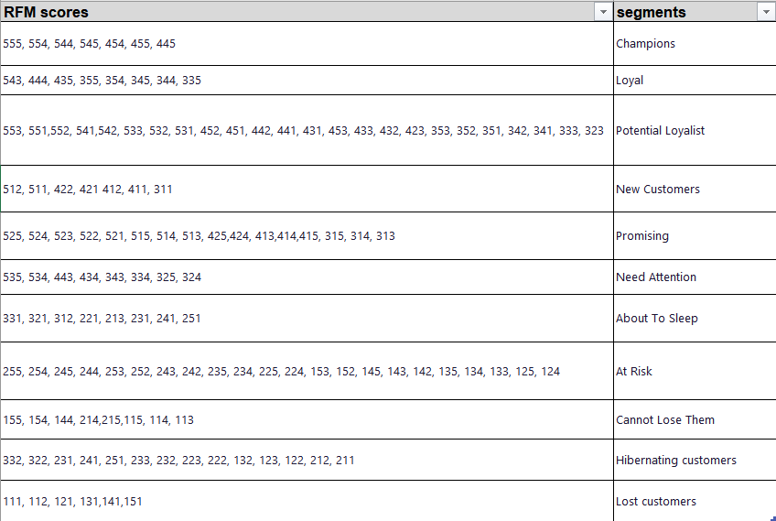
Model development
Recency, frequency and monetary RFM score
RFM Score:
Finally, we can rank these customers by combining their individual R, F, and M rankings to arrive at an aggregated RFM score. This RFM score, displayed in the table below, is simply the average of the individual R, F, and M scores, obtained by giving equal weights to each RFM attribute.

Slide 9
Suggestions:
Collection of feedback and working on flaws may improve sales.
Watch review pages and we may draw insights from them.
Production of products based on budget may also be helpful.

Slide 10
Thank you

